Slide 1

Real-world Anomaly Detection in Surveillance Videos
Waqas Sultani, Chen Chen, Mubarak Shah
(CVPR2018)
Wang Wu
Jan. 04. 2019

Slide 2
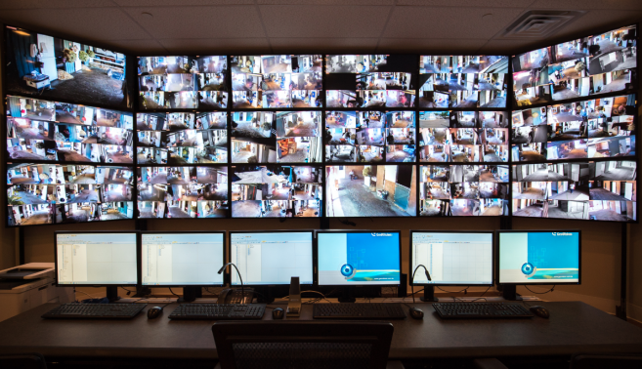
Motivation
Surveillance cameras are increasingly being used in public places
The monitoring capability of law enforcement agencies has not kept pace
Develop intelligent algorithms for automatic video anomaly detection to alleviate the waste of labor and time

Slide 3
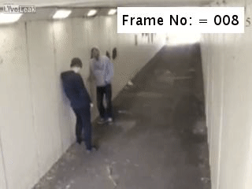
Anomaly Detection Example
anomalous events rarely occur as compared to normal activities
it is very difficult or impossible to define a normal event which takes all possible normal patterns/behaviors into account

Slide 4
Limitations of Previous Approaches
Detect a specific anomalous event, e.g. traffic accident
Generalization issue
Sparse-coding based approaches
Assume the initial portion of a video contains normal events for building the normal event dictionary
Do not handle environmental change well
Produce high false alarm rates for different normal behaviors

Slide 5
Approach of this paper
Goal– identity the time window of the anomaly in a long surveillance video
Learn anomalies by exploiting both normal and anomalous videos

Slide 6
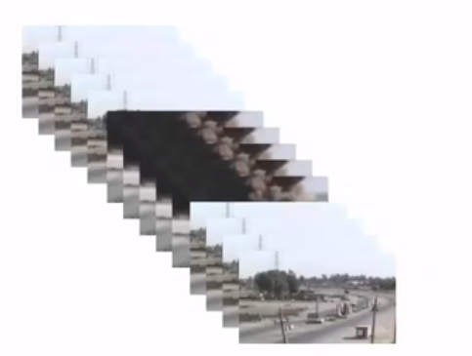
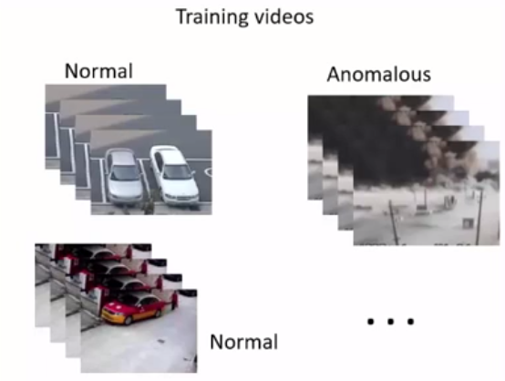
Approach of this paper
Using weakly labeled training videos
Training Videos
Normal
Time
Anomalous
Anomalous segment
(temporal location)
. . .
?
Normal

Slide 7
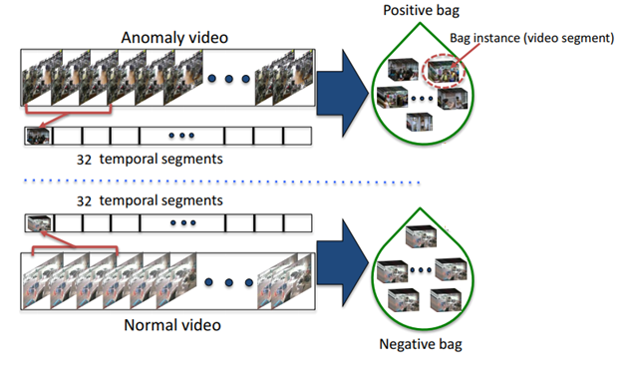
Approach of this paper
Multiple Instance Learning

Slide 8
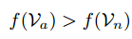
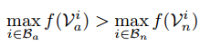
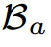
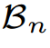
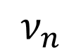
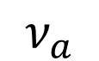
Approach of this paper
MIL Ranking Model
If the segment-level annotations (labor intensive) are known
$$ν_{a}$$
anomalous video segments
Ranking loss encourage
$$ν_{n}$$
normal video segments
Multiple Instance Learning (MIL) ranking for anomaly detection
anomalous video as a Bag of instances
normal video as a Bag of instances
highest anomaly score in the anomalous bag– most likely a true positive instance
highest anomaly score in the normal bag– looks most similar to an anomalous segment

Slide 9
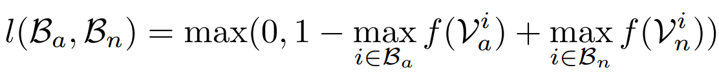
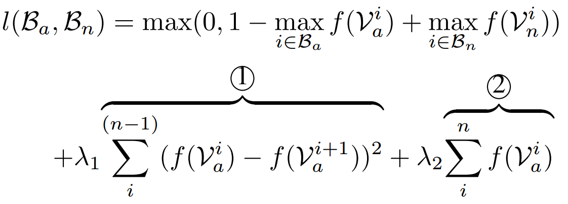
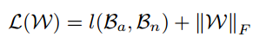
Approach of this paper
MIL Ranking Model
Ranking loss in the hinge-loss formulation
Smoothness(1) and Sparsity (2) constrains
Anomaly score (0~1)
objective function

Slide 10
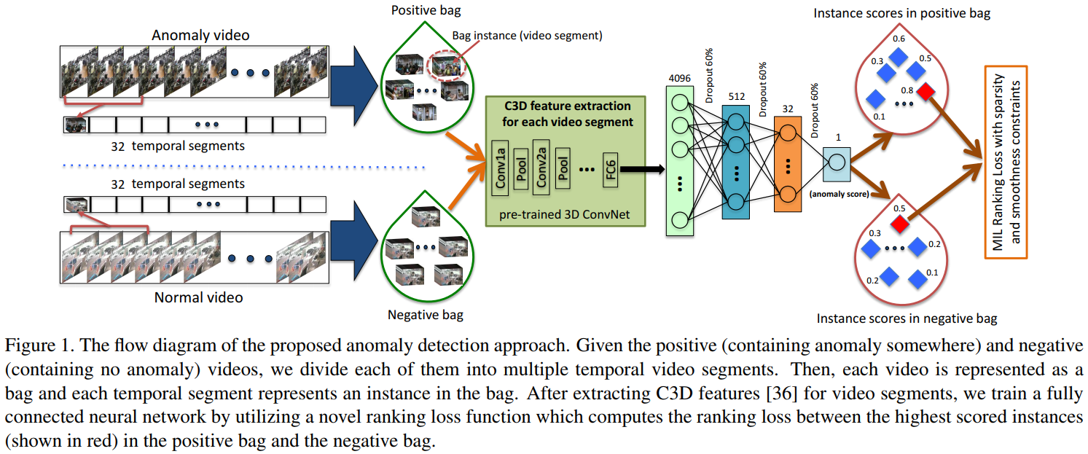
Anomaly Detection Framework

Slide 11
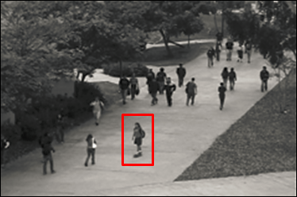
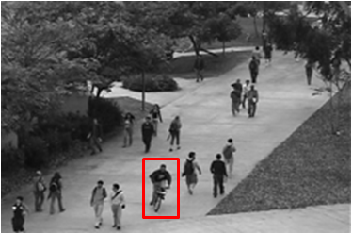
Limitations of Previous Datasets
Simple anomalies (wrong direction, running, etc.)
Staged, unrealistic anomalies
Video are captured at one location
UCSD dataset

Slide 12
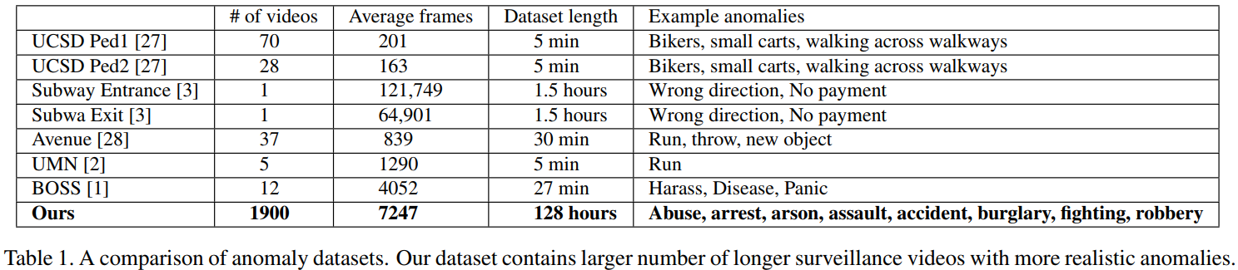
UCF-Crime Dataset
1,900 real-world surveillance videos of 128 hours
15 times more videos than existing datasets
13 real-world anomalies

Slide 13
UCF-Crime Dataset
Anomaly | Number of videos
Burglary | 100
Fighting | 50
Road Accidents | 150
Robbery | 150
Shooting | 50
Shoplifting | 50
Stealing | 100
Abuse | 50
Arrest | 50
Arson | 50
Assault | 50
Explosion | 50
Vandalism | 50
Normal | 950

Slide 14
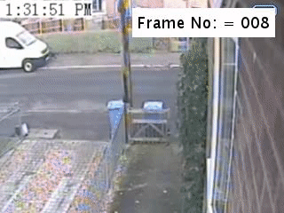
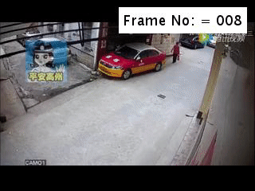
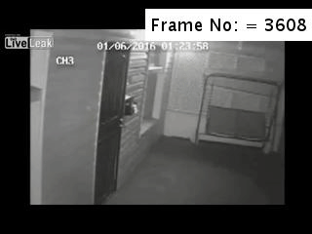
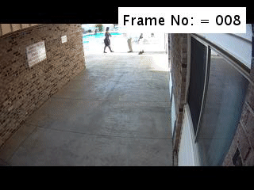
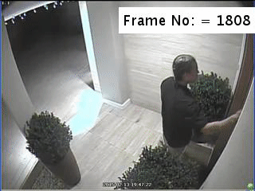
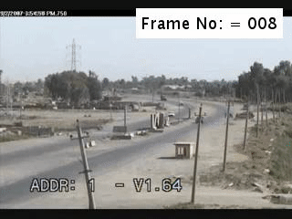
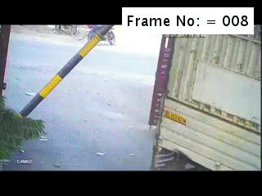
UCF-Crime Dataset
Abuse
Arrest
Arson
Assault
Burglary
Explosion
Fighting
Road accident

Slide 15
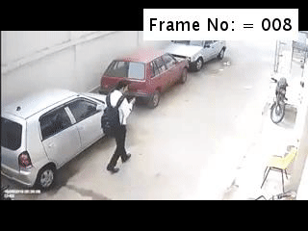
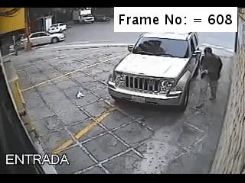
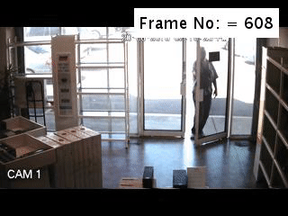
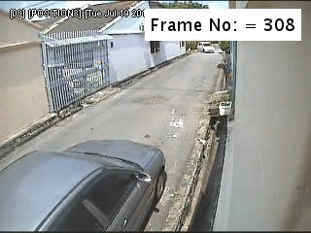
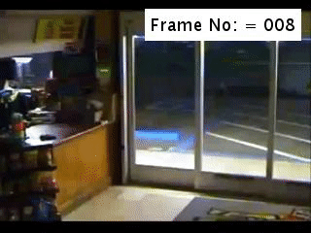
UCF-Crime Dataset
Robbery
Shooting
Shoplifting
Stealing
Vandalism
Normal Event

Slide 16
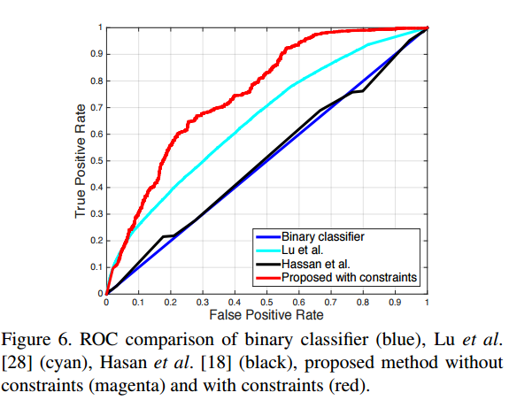
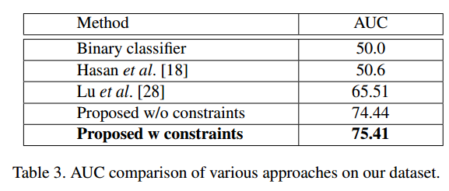
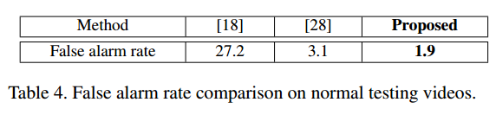
Experiment
The training set: 800 normal and 810 anomalous videos
The testing set: remaining 150 normal and 140 anomalous videos

Slide 17
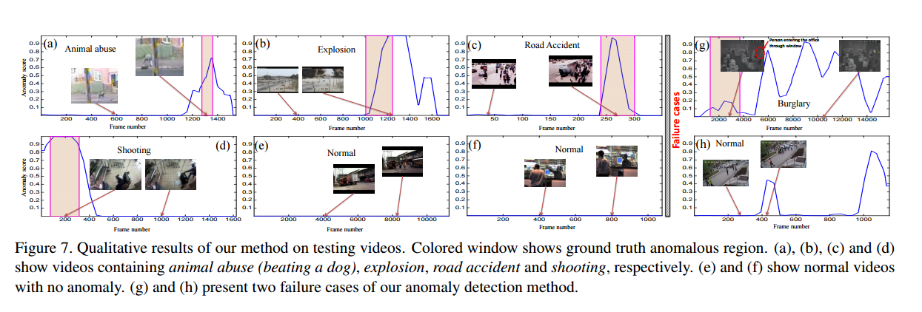
Anomaly Detection Results

Slide 18
THANKS

